Slide 1
Statistics
Dhrub Satyam
(Data Scientist)

Slide 2
What is Statistics?
Statistics is a mathematical science including methods of collecting, organizing and analyzing data in such a way that meaningful conclusions can be drawn from them. In general, its investigations and analyses fall into two broad categories called descriptive and inferential statistics.

Slide 3
Developing Statistical Thinking
Statistics include numerical facts and figures. For instance:
• The largest earthquake measured 9.2 on the Richter scale.
• Men are at least 10 times more likely than women to commit murder.
• One in every 8 Americans is COVID positive.
The study of statistics involves math and relies upon calculations of numbers. But it also relies heavily on how the numbers are chosen and how the statistics are interpreted. For example, consider some scenarios and the interpretations based upon the presented statistics.
1. A new advertisement for Amul’s ice cream introduced in late May of last year resulted in a 30% increase in ice cream sales for the following three months. Thus, the advertisement was effective.
2. The more liquor shop in a city, the more crime there is. Thus, liquor shops lead to crime.

Slide 4
Flaw: A major flaw is that ice cream consumption generally increases in the months of June, July, and August regardless of advertisements. This effect is called a history effect and leads people to interpret outcomes as the result of one variable when another variable (in this case, one having to do with the passage of time) is actually responsible.
Flaw: A major flaw is that both increased liquor shops and increased crime rates can be explained by larger populations. In bigger cities, there are both more liquor shops and more crime. This problem refers to the third-variable problem. Namely, a third variable can cause both situations; however, people erroneously believe that there is a causal relationship between the two primary variables rather than recognize that a third variable can cause both.
Hence, the correct Interpretation of the numbers are necessary!!!!

Slide 5
Types of Statistics:
1. Descriptive statistics deals with the processing of data without attempting to draw any inferences from it. The characteristics of the data are described in simple terms. Events that are dealt with include everyday happenings such as accidents, prices of goods, business, incomes, epidemics, sports data, population data.
2. Inferential statistics is a scientific discipline that uses mathematical tools to make forecasts and projections by analysing the given data. This is of use to people employed in such fields as engineering, economics, biology, the social sciences, business, agriculture and communications.

Slide 6
Population?
Refers to the total amount of things.
Sample?
Small part of population that is used for study.
Sample Size?
Total amount of things in a sample.
Variable?
What we are studying. (Measurable, Countable, Categorized)
Notes:
Variable: How a particular person can have different heights, weights and hair colour. These are variables. It refers to characteristics of what we are studying. Can vary among different individuals.

Slide 7
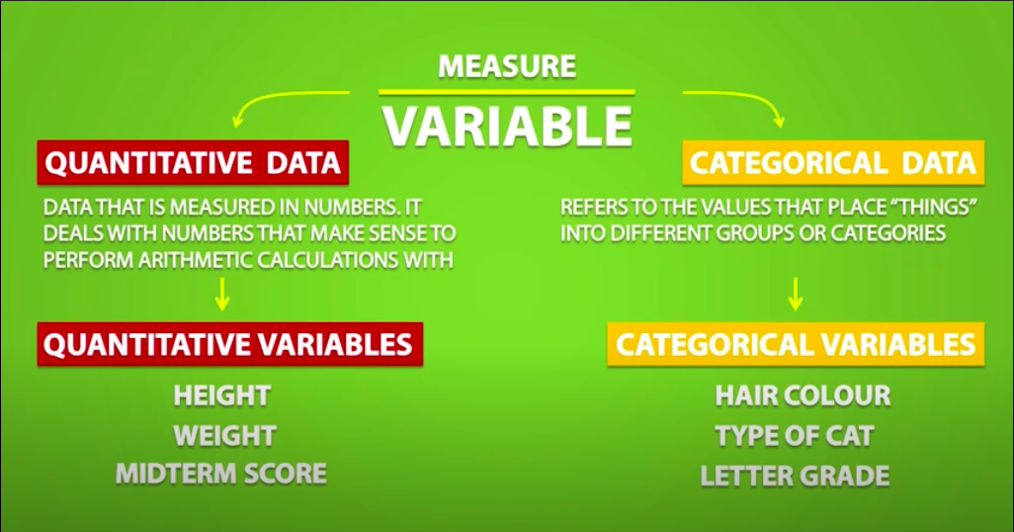

Slide 8
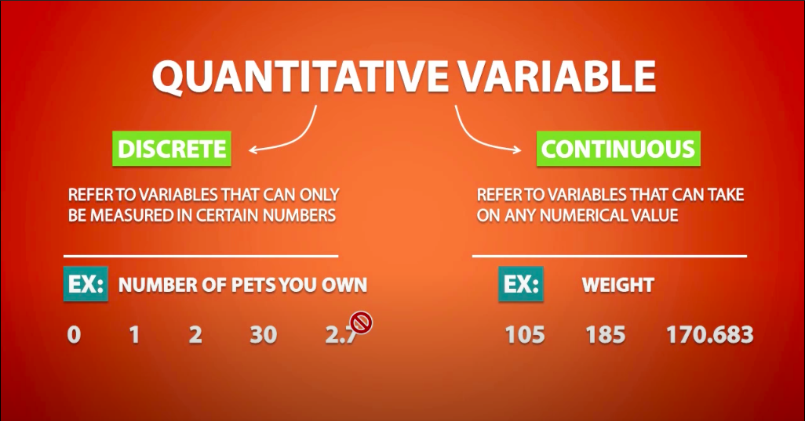

Slide 9
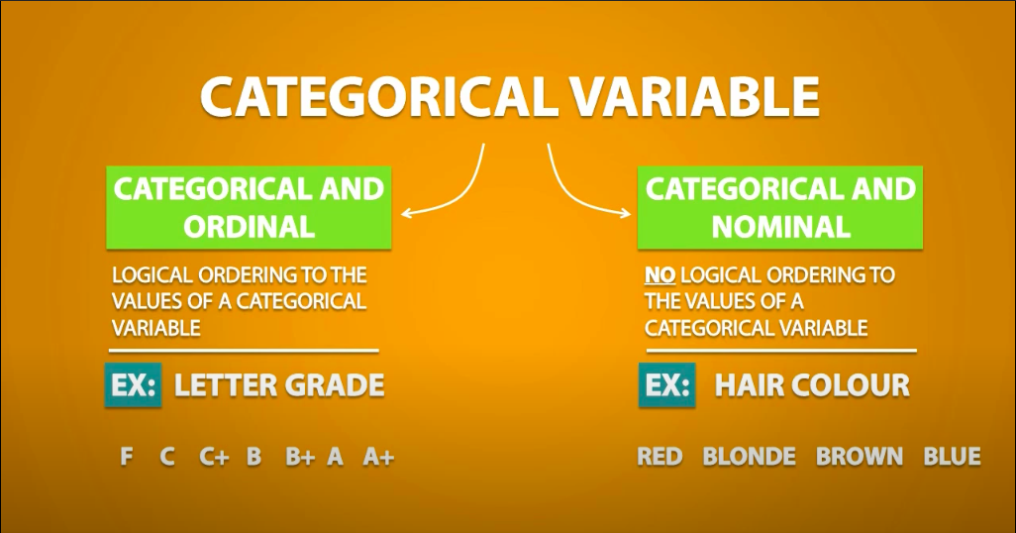

Slide 10
The difference between interval and ratio scales comes from their ability to dip below zero. Interval scales hold no true zero and can represent values below zero. For example, you can measure temperature below 0 degrees Celsius, such as -10 degrees.
Ratio variables, on the other hand, never fall below zero. Height and weight measure from 0 and above, but never fall below it.
QUANTITATIVE VARIABLE
INTERVAL
RATIO
An interval scale is one where there is order and
the difference between two values is meaningful.
A ratio variable, has all the properties of an interval variable, and also has a clear definition of 0.
Temperature (Fahrenheit), Temperature (Celsius), pH,
Weight, length, temperature in Kelvin
Ex:
Ex:

Slide 11
Data Visualization Basics
What is data Visualization?
Data visualization is the representation of data or information in a graph, chart, or other visual format. It communicates relationships of the data with images. This is important because it allows trends and patterns to be more easily seen.
What is its importance?
We need data visualization because a visual summary of information makes it easier to identify patterns and trends than looking through thousands of rows on a spreadsheet. It’s the way the human brain works.
Since the purpose of data analysis is to gain insights, data is much more valuable when it is visualized.
Even if a data analyst can pull insights from data without visualization, it will be more difficult to communicate the meaning without visualization.
Charts and graphs make communicating data findings easier even if you can identify the patterns without them.

Slide 12
Line Chart.
A line chart is, as one can imagine, a line or multiple lines showing how single, or multiple variables develop over time.
Pie Chart.
A pie chart is a circular graph divided into slices. The larger a slice is the bigger portion of the total quantity it represents.
Bar Graph.
A bar chart or bar graph is a chart or graph that presents categorical data with rectangular bars with heights or lengths proportional to the values that they represent. The bars can be plotted vertically or horizontally. Can be of one variable or many variable.
Histogram
A series of bins showing us the frequency of observations of a given variable.
Scatter Plots
A scatter plot is a great indicator that allows us to see whether there is a pattern to be found between two variables. E.g. : Positive or negative relationship.

Slide 13
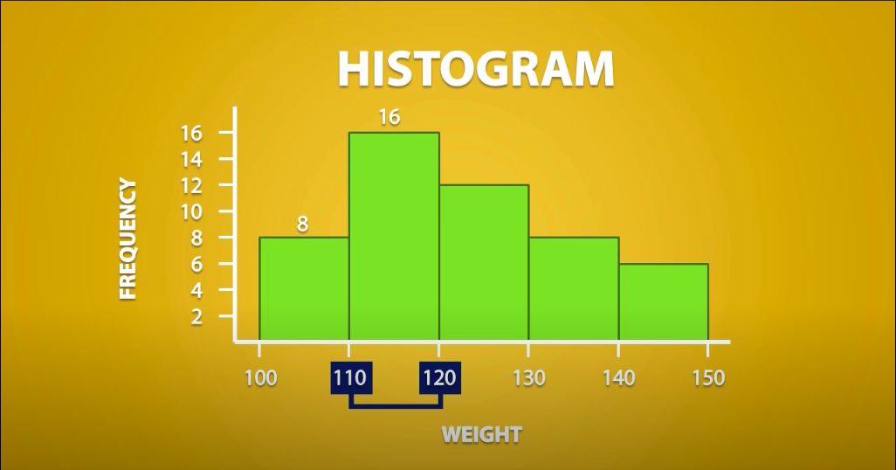

Slide 14
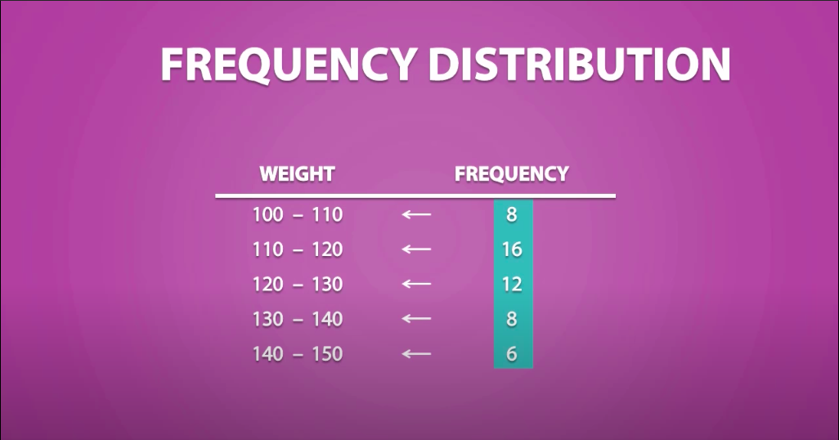

Slide 15
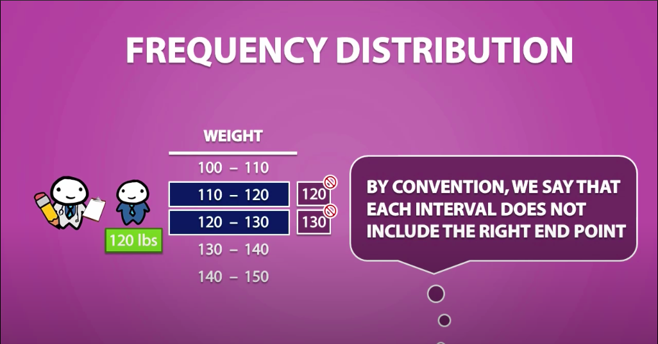
Notes:
But You can say that, we can exclude the value 120 from the earlier interval. But we cannot do that. Why? Because if we remove the end point then it is not continuous (E.g.: where will we keep the 119.98765?)

Slide 16
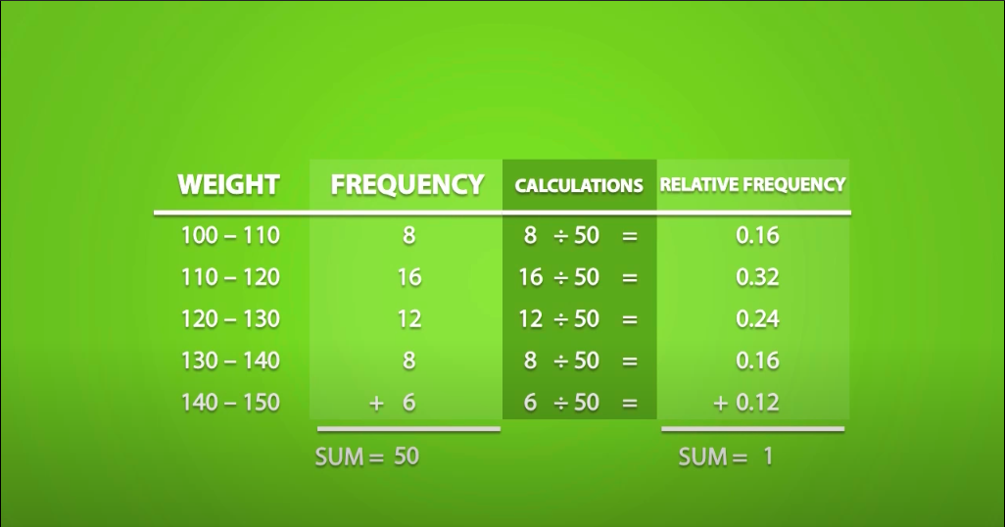

Slide 17
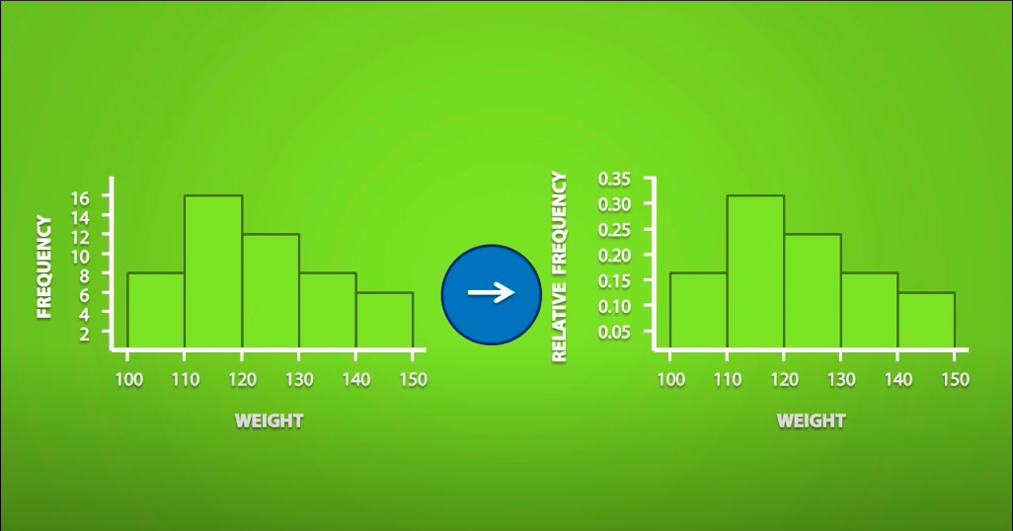

Slide 18
Descriptive Statistics
deals with the processing of data without attempting to draw any inferences from it. The characteristics of the data are described in simple terms. Events that are dealt with include everyday happenings such as accidents, prices of goods, business, incomes, epidemics, sports data, population data.
When we give description of data, there can be 3 kinds:
Measures of Central Tendency – Mean, Median and Mode
Measures of Dispersion – Standard Deviation, Variance, Range, IQR (Inter Quartile Range)
Measure of Symmetricity/Shape – Skewness and Kurtosis

Slide 19
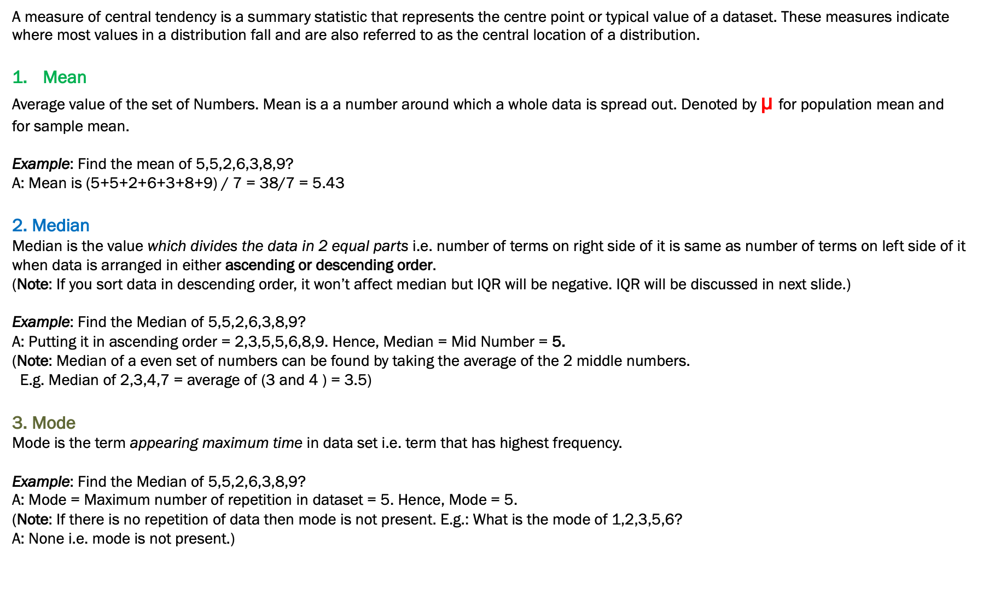
1. Measure of Central Tendency
A measure of central tendency is a summary statistic that represents the centre point or typical value of a dataset. These measures indicate where most values in a distribution fall and are also referred to as the central location of a distribution.
Mean
Average value of the set of Numbers. Mean is a a number around which a whole data is spread out. Denoted by µ for population mean and
for sample mean.
Example: Find the mean of 5,5,2,6,3,8,9?
A: Mean is (5+5+2+6+3+8+9) / 7 = 38/7 = 5.43
2. Median
Median is the value which divides the data in 2 equal parts i.e. number of terms on right side of it is same as number of terms on left side of it when data is arranged in either ascending or descending order.
(Note: If you sort data in descending order, it won’t affect median but IQR will be negative. IQR will be discussed in next slide.)
Example: Find the Median of 5,5,2,6,3,8,9?
A: Putting it in ascending order = 2,3,5,5,6,8,9. Hence, Median = Mid Number = 5.
(Note: Median of a even set of numbers can be found by taking the average of the 2 middle numbers.
E.g. Median of 2,3,4,7 = average of (3 and 4 ) = 3.5)
3. Mode
Mode is the term appearing maximum time in data set i.e. term that has highest frequency.
Example: Find the Median of 5,5,2,6,3,8,9?
A: Mode = Maximum number of repetition in dataset = 5. Hence, Mode = 5.
(Note: If there is no repetition of data then mode is not present. E.g.: What is the mode of 1,2,3,5,6?
A: None i.e. mode is not present.)

Slide 20
Let’s build some concepts before going ahead.
1. What is Minimum and Maximum value?
It is the minimum and Maximum values of the dataset respectively.
2. What is 1st and 3rd Quartile? – Also called the lower and upper quartile respectively.
When we divide the dataset into two groups while calculating median (sorted in ascending order), then the median of first half is 1st Quartile and median of second half is 3rd Quartile.
3. Then where is the 2nd Quartile?
Your median is the 2nd Quartile ;-)

Slide 21
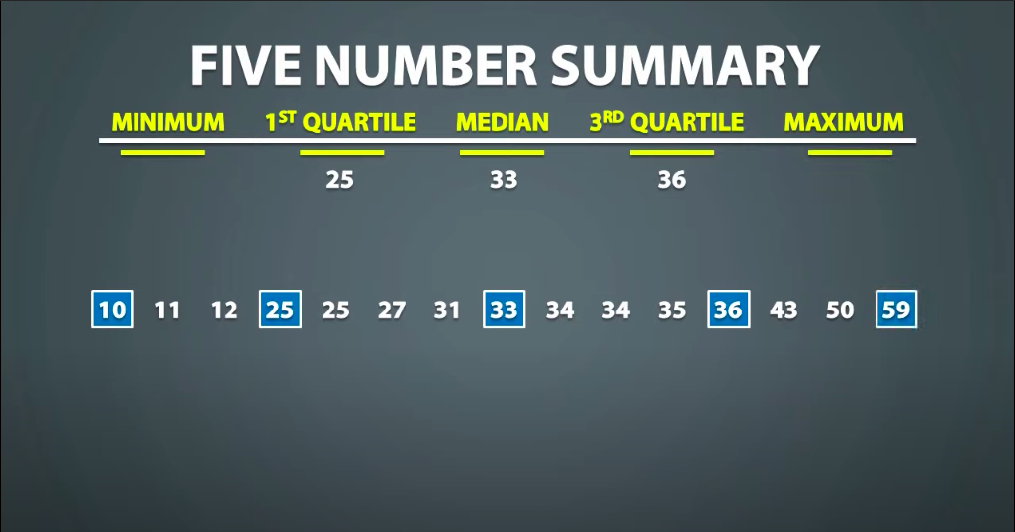




Slide 22


Q. Given is the ages of people registered for a webinar, calculate the 5 point summary (5 number summary) of
the ages of the participants?
19, 26, 25, 37, 32, 28, 22, 23, 29, 34, 39, 31

Slide 23










19, 26, 25, 37, 32, 28, 22, 23, 29, 34, 39, 31

Slide 24





Slide 25
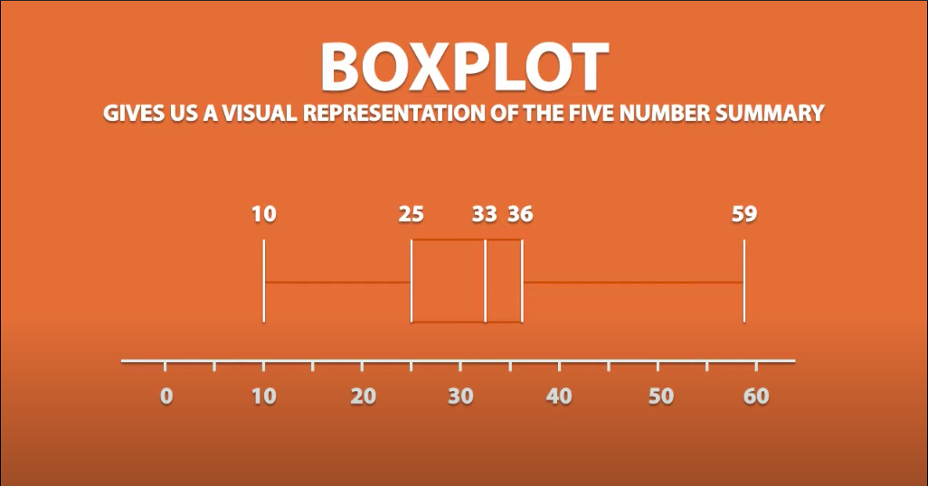








Slide 26
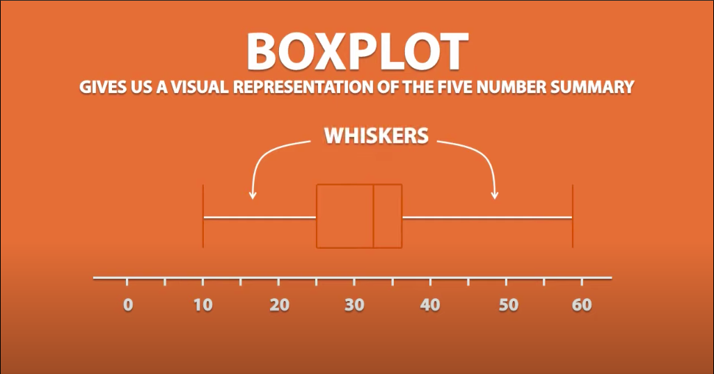










Slide 27
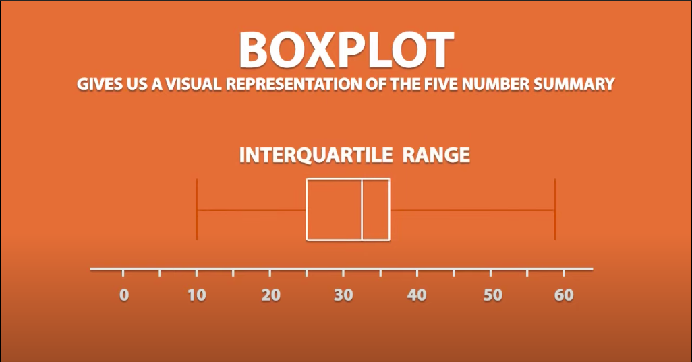






Slide 28

















2. Measure of Spread / Dispersion
1. Standard deviation
Standard deviation is the measurement of average distance between each quantity and mean. That is, how data is spread out from mean. A low standard deviation indicates that the data points tend to be close to the mean of the data set, while a high standard deviation indicates that the data points are spread out over a wider range of values.
In Python :
Population STD = pstdev()
Sample STD = stdev()
SD of Population
(σ)
i
SD of Sample
(s)
i

Slide 29

























Slide 30












Slide 31
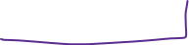









Measure of Spread / Dispersion
2. Variance
Variance is a square of average distance between each quantity and mean. That is, it is square of standard deviation.
In Python : Population Var = pvariance() Sample Variance = variance()
3. Range
Range is one of the simplest techniques of descriptive statistics. It is the difference between lowest and highest value.
Range = Maximum - Minimum
4. IQR (Interquartile Range)
In statistics and probability, quartiles are values that divide your data into quarters provided data is sorted in an ascending order.
IQR = Q3 – Q1
Population Variance
(σ²)
Sample Variance
(S²)
i
i

Slide 32







Measure of Spread / Dispersion
Steps to find out the IQR
Order the data from least to greatest
Find the median
The left side of median is lower half and right side of the data is upper half.
Calculate the median of both the lower and upper half of the data (Called Q1 and Q3 respectively)
The IQR is the difference between the upper and lower medians
(Note: When we write down Minimum, Maximum, Q1, Q2 (Median) and Q3, this is called 5-point summary or 5 number summary)
Let’s solve some questions to find IQR.

Slide 33















Transforming Data
Look at below Question.
Below are the weights of 5 persons. Calculate Mean, Standard Deviation :
105, 156, 145, 172, 100
2. Suppose each one of them gained extra 5 Kg. weight during winters. Can you calculate the new Mean and Standard deviation?

Slide 34






Transforming Data
Example 2:
Considering the same set of people from previous example, Suppose that these persons are advised to drink
2.5 ml of water for every Kg they weigh plus 750 ml of water everyday.
105, 156, 145, 172, 100
What is the mean and STD for the amount of water consumed everyday?

Slide 35
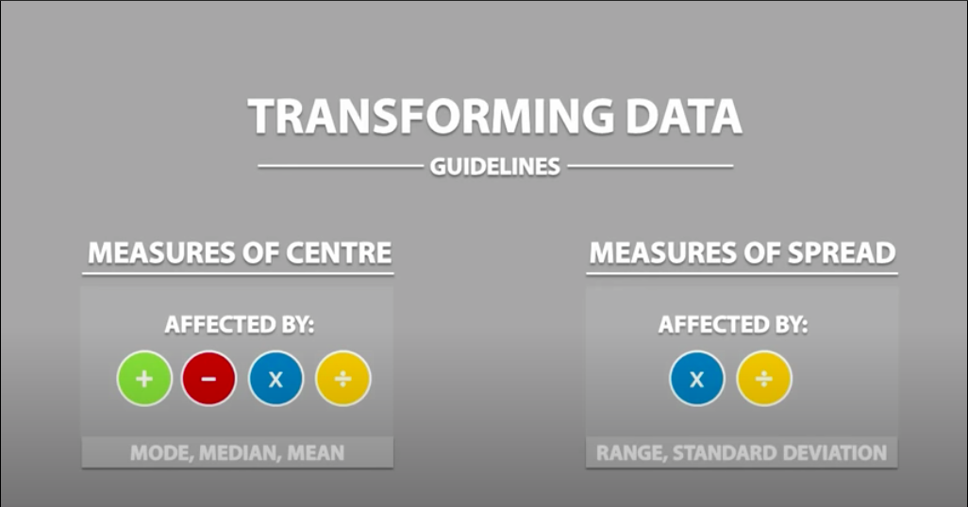




Slide 37
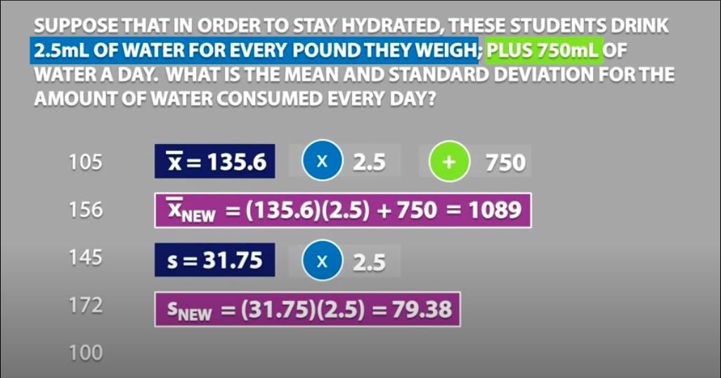











Slide 38
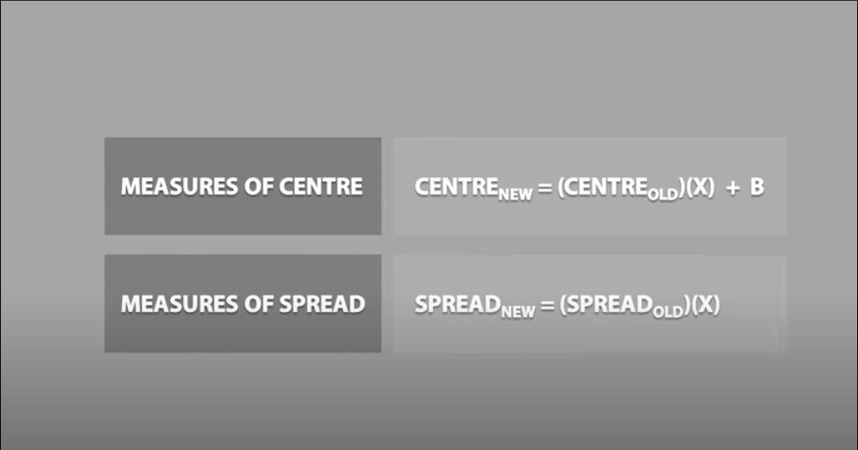
Multiplicative
term
Additive
term
Multiplicative
term

Slide 39
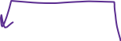


3. Measure of symmetricity – Skewness and Kurtosis

Slide 40
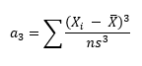


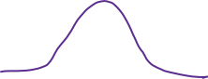


1. Skewness
Skewness is usually described as a measure of a dataset’s symmetry – or lack of symmetry. A perfectly symmetrical data set will have a skewness of 0. The normal distribution has a skewness of 0. Skewness is calculated as:
import numpy as np
from scipy.stats import skew
x = np.random.normal(0, 2, 10000) # create random values based on a normal distribution print(skew(x))
….
Mathematically:
where n is the sample size, X_{i} is the i^{th} X value, X-Bar is the average and s is the sample standard deviation. Note the exponent in the summation. It is “3”. The skewness is referred to as the “third standardized central moment for the probability model.”

Slide 41










Skewness
So, when is the skewness too much? The rule of thumb seems to be:
If the skewness is between -0.5 and 0.5, the data are fairly symmetrical.
If the skewness is between -1 and – 0.5 or between 0.5 and 1, the data are moderately skewed.
If the skewness is less than -1 or greater than 1, the data are highly skewed.
Importance of Skewness:
Measures of asymmetry like skewness are the link between central tendency measures and probability theory, which ultimately allows us to get a more complete understanding of the data we are working with.
Knowing that the market has a 70% probability of going up and a 30% probability of going down may appear helpful if you rely on normal distributions. However, if you were told that if the market goes up, it will go up 2% and if it goes down, it will go down 10%, then you could see the skewed returns and make a better informed decision.
E(r) = 0.7*0.02 + 0.3*-0.1 = -0.014

Slide 42
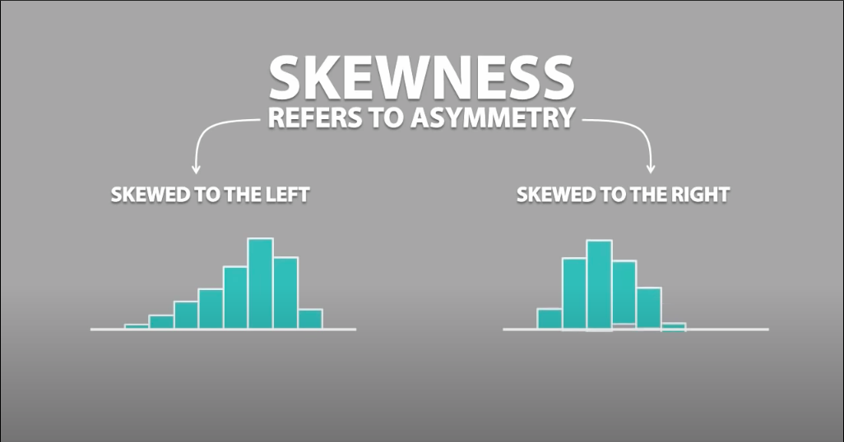



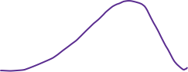



Slide 43
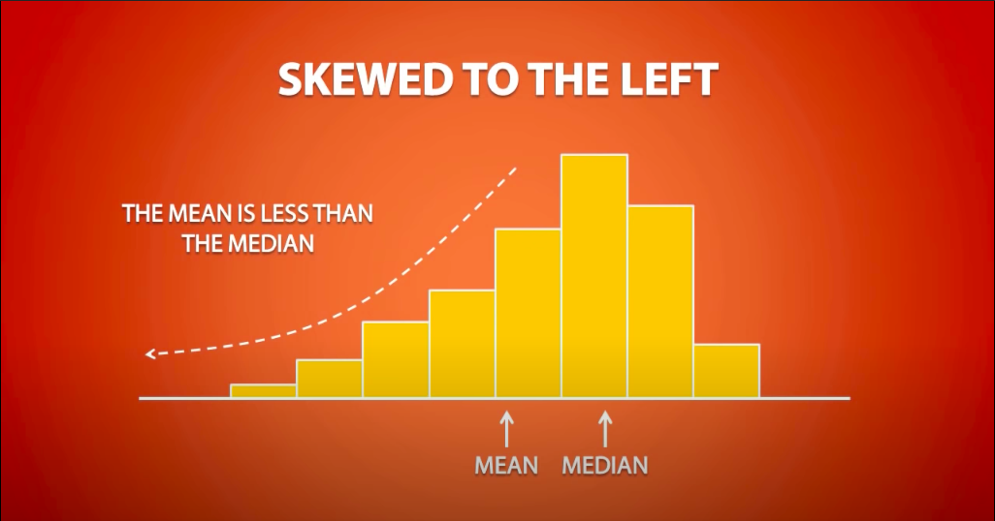
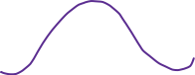



Slide 44
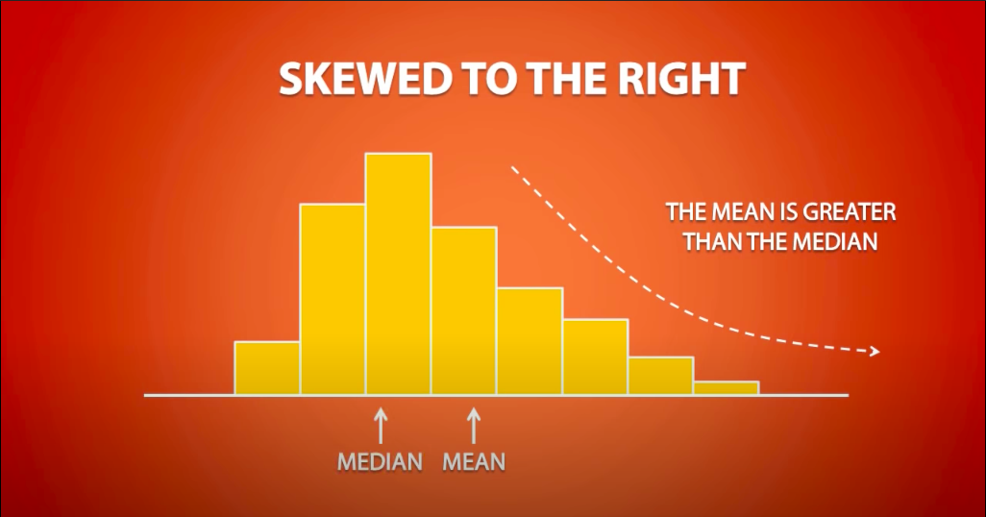














Slide 45




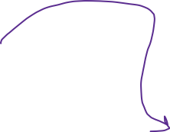











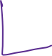







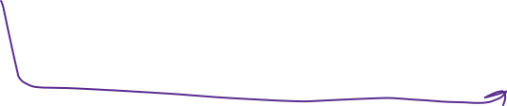

Slide 46
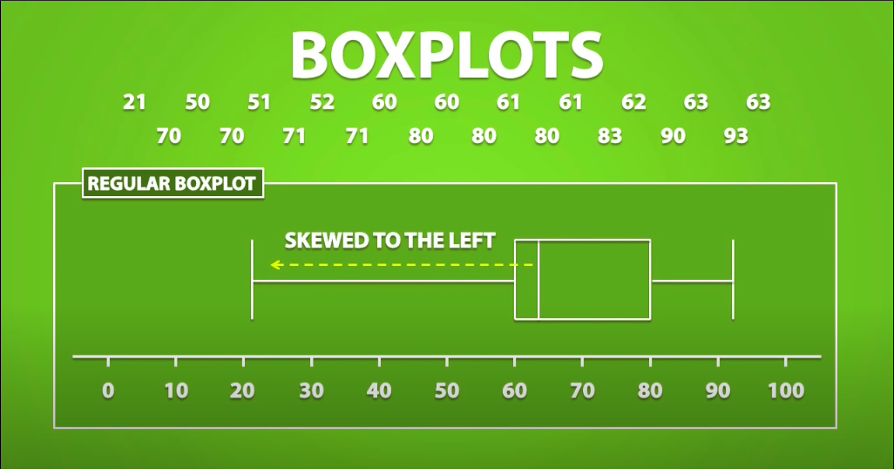




Slide 47
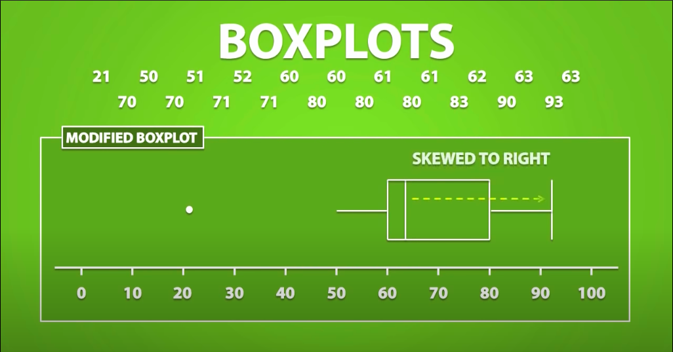


Slide 48
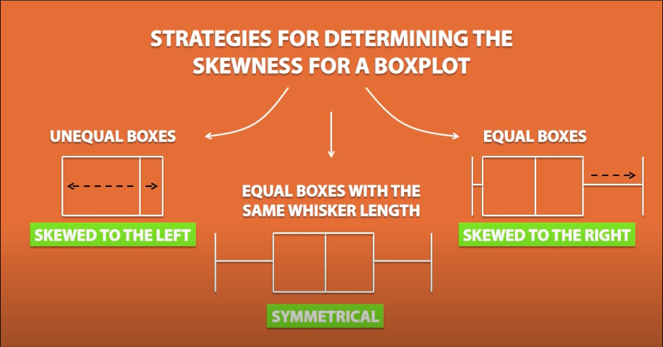






Slide 49
















Slide 50
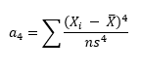
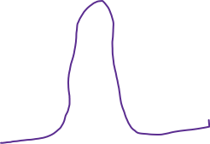
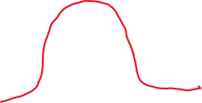
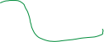

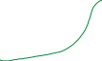



2. Kurtosis
Kurtosis is all about the tails of the distribution – not the peakness or flatness. It measures the tail-heaviness of the distribution. Kurtosis is calculated as:
import numpy as np
from scipy.stats import kurtosis
x = np.random.normal(0, 2, 10000) # create random values based on a normal distribution
print(kurtosis(x))
Mathematically:
where n is the sample size, X_{i} is the i^{th} X value, X-Bar is the average and s is the sample standard deviation. Note the exponent in the summation. It is “4”. The kurtosis is referred to as the “fourth standardized central moment for the probability model.”
Note: Kurtosis calculated by Excel or through Python/R is actually excess kurtosis, which is (Kurtosis – 3)

Slide 51


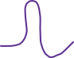



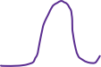
What does the value of Kurtosis tells about the shape?
The reference standard is a normal distribution, which has a kurtosis of 3. In token of this, often the excess kurtosis is presented: excess kurtosis is simply kurtosis−3. For example, the “kurtosis” reported by Excel or any statistical library is actually the excess kurtosis.
1. A normal distribution has kurtosis exactly 3 (excess kurtosis exactly 0). Any distribution with kurtosis ≈3 (excess ≈0) is called mesokurtic.
2. A distribution with kurtosis <3 (excess kurtosis <0) is called platykurtic. Compared to a normal distribution, its tails are shorter and thinner, and often its central peak is lower and broader.
3. A distribution with kurtosis >3 (excess kurtosis >0) is called leptokurtic. Compared to a normal distribution, its tails are longer and fatter, and often its central peak is higher and sharper.

Slide 52











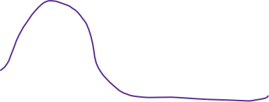
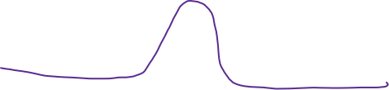


Uses of Kurtosis:
1. Depicts the shape of the distribution - specially tails.
2. Outlier Detection : Large Kurtosis suggests there could be outliers in the data.
3. With high kurtosis, there is a chance of high variance and hence test on Mean could lead to bad results.
Hence, in that case, we would need to choose a more robust option – like test on Median.
4. Financial Risk: E.g. The return of your asset can be farther from the mean. (Than predicted using normal
distribution).

Slide 53
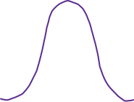

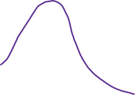

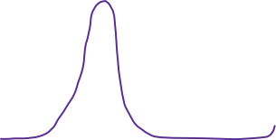

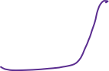

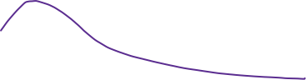

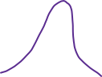



Slide 54





Outliers
What is outlier?
An outlier is an observation that lies an abnormal distance from other values in a random sample from a population. In a sense, this definition leaves it up to the analyst to decide what will be considered abnormal.
Common Causes of Outliers
Data entry errors (human errors)
Measurement errors (instrument errors)
Experimental errors (data extraction or experiment planning/executing errors)
Intentional (dummy outliers made to test detection methods)
Data processing errors (data manipulation or data set unintended mutations)
Sampling errors (extracting or mixing data from wrong or various sources)
Natural (not an error, novelties in data)

Slide 55
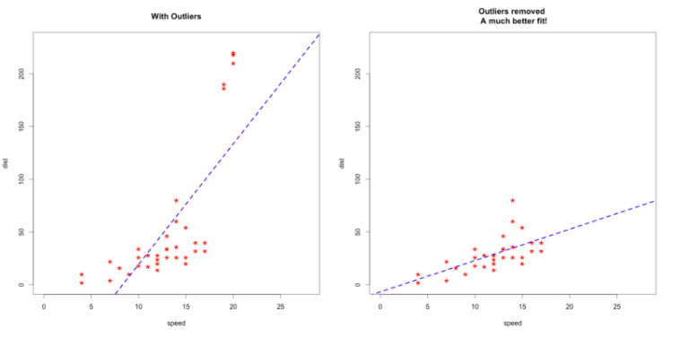




Common methods of determining an Outlier
1. Sort the data and see for the extreme values
2. Plotting – Boxplot, Scatterplot
3. IQR Method
4. Z-Score Method
Why do we need to treat outliers?
Outliers can impact the results of our analysis and statistical modelling in a drastic way.

Slide 56
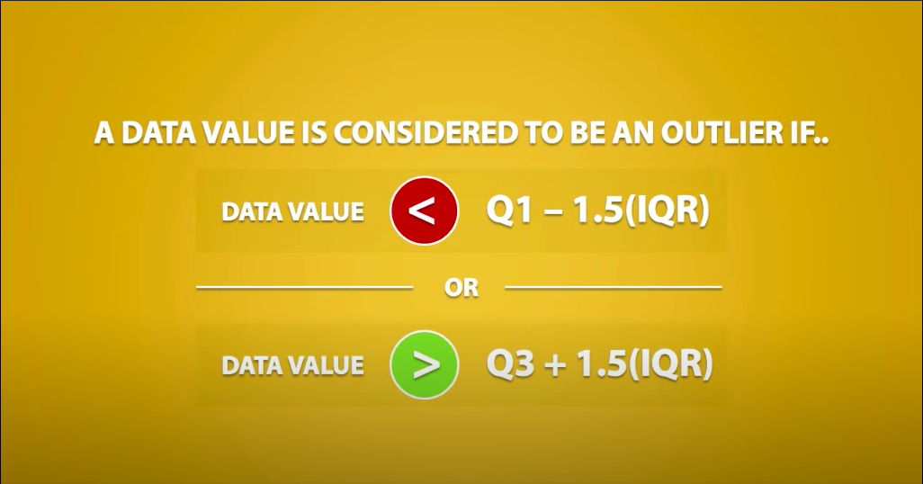





IQR Method

Slide 57






















Slide 58





Q. Can you identify the outliers from the below dataset, using the IQR method?
26.0 ℃ , 15.0 ℃ , 20.5 ℃ , 31 ℃ , -350.0 ℃ , 31.0 ℃ , 30.5 ℃

Slide 59




Outliers < Q1 – 1.5 (IQR)
> Q3 + 1.5 (IQR)
25 – 1.5 (11) = 8.5
36 + 1.5 (11) = 52.5
Hence, we can say that 59 is the only outlier we have in our dataset.

Slide 60
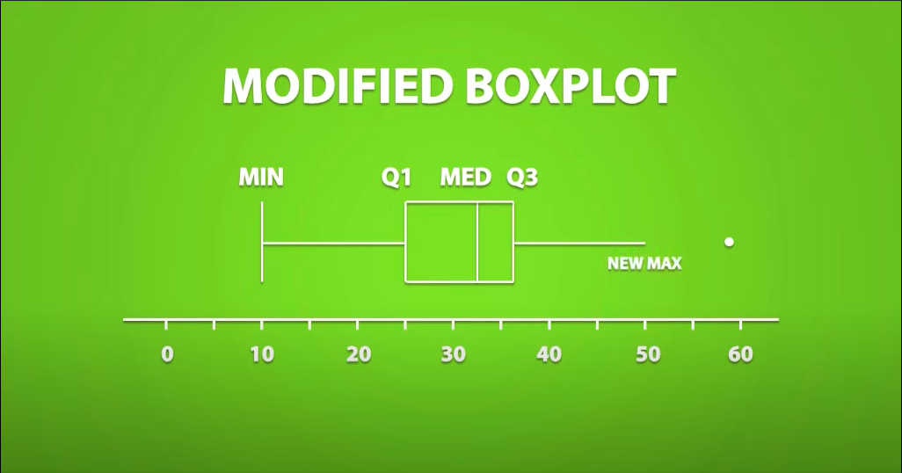












Slide 61
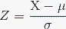













Z-Score Method
What is Z-Score?
Z-scores can quantify the unusualness of an observation when your data follow the normal distribution. Z-scores are the number of standard deviations above and below the mean that each value falls, assuming a Normal distribution.
For example, a Z-score of 2 indicates that an observation is two standard deviations above the average while a Z-score of -2 signifies it is two standard deviations below the mean.
Z-Score Formula?
Point to understand:
The further away an observation’s Z-score is from zero, the more unusual it is. A standard cut-off value for finding outliers are Z-scores of +/-3 or further from zero. In a population that follows the normal distribution, Z-score values more extreme than +/- 3 have a probability of 0.0027 (2 * 0.00135), which is about 1 in 370 observations.

Slide 62


















Slide 63














Example: Consider the below dataset. Find out the outlier using Z-score method.
1, 2, 2, 2, 3, 1, 1, 15, 2, 2, 2, 3, 1, 1, 2
Solution:
Mean = 2.66
Std = 3.36
Ref:
Z score formula =
Z (1) = (1 – 2.66)/3.36 = -0.49405
Z(2) = (2 – 2.66)/3.36 = -0.19643
Z(3) = (3 – 2.66)/3.36 = 0.10119
Z(15) = (15 – 2.66)/3.36 = 3.67262
We will term the point outlier if it has a z-score of 3 or above (in any side - positive or negative).
Hence, here the outlier is 15.

Slide 64
Covariance

Slide 65

Covariance
In Python: use cov() function
x > μ_{x,} y > μ_{y}
+
+
x < μ_{x,} y < μ_{y}
-
-
x > μ_{x,}
y < μ_{y}
+
-
x < μ_{x,}
y > μ_{y}
-
+

Slide 66
Correlation

Slide 67

What is Correlation?
Correlation is a statistical technique to depict the relationship between 2 variables – strength and direction. We measure the correlation with the help of Correlation Coefficient.
For example, height and weight are related; taller people tend to be heavier than shorter people.
What is Correlation Coefficient?
The Pearson’s correlation coefficient (r) is a measure that determines the degree to which the movement of two variables is associated. The value of Correlation Coefficient lies between -1 and 1.
Formula: (Pearson’s Correlation Coefficient) - Standard Formula
In Python: DataFrame.corr(method=’pearson’)
(n = sample size, and Sx, Sy are the standard deviation of samples x and y. X-bar and y-bar are the respective means of x and y samples whereas Xi and Yi are sample points of X and Y respectively.)

Slide 68
Positive and Negative Correlation:
Correlation Coefficient greater than zero indicates a positive relationship
2. while a value less than zero signifies a negative relationship
3. and a value of zero indicates no relationship between the two variables being compared.

Slide 69
Strong and Weak Correlation:
Kind of correlation = depicted by sign of correlation coefficient
How Strong =. Value of Correlation Coefficient

Slide 70

Rule of thumb: Any relationship with magnitude of r greater than 0.75 can be considered to be a strong correlation.
E.g.: -0.84 is a strong Negative correlation and 0.90 is a strong positive correlation.

Slide 71


Slide 72


Slide 73
Question: The local ice cream shop keeps track of how much ice cream they sell versus the temperature on that day, here are their figures for the last 12 days. Can you tell if Ice cream sales are correlated to that of temperature? Find out the nature and strength of correlation.
Temperature | Ice Cream Sales
14.2° | $215
16.4° | $325
11.9° | $185
15.2° | $332
18.5° | $406
22.1° | $522
19.4° | $412
25.1° | $614
23.4° | $544
18.1° | $421
22.6° | $445
17.2° | $408

Slide 74

Spearman Rank Correlation
Used for Non-Linear Variables
Spearman Corr Coeff = Pearson Corr coeff (rank varaibles)
In Python: DataFrame.corr(method=’spearman’)
Denoted by rho.

Slide 75
Steps for Spearman Correlation Coefficient
Create a new column for rank(x) and assign the rank of each variable.
Assign the rank of 2nd variable in a new column rank(y).
Calculate the difference in rank of both the variables = d.
Calculate the d-squared.
Add up d-squared score.
Put in the formula provided:

Slide 76

Question: The scores for 10 students in English and Maths are as follows:
Compute the Spearman rank correlation.

Slide 77

Solution:
Step 1,2,3 and 4:

Slide 78
Solution Contd.
Step 5:
Step 6:
Hence, the Spearman Rank Coefficient is 0.67.

Slide 79

Points to Ponder (Correlation):
Example: A few years ago a survey of employees found a strong positive correlation between "Studying an external course" and Sick Leave Days.
Does this mean?
Studying makes them sick?
Sick people study a lot?
Or did they lie about being sick so they can study more?
Without further research we can't be sure why. :-D
Example: Poor suburbs are more likely to have high pollution.
Why?
Do poor people make pollution?
Are polluted suburbs the only place poor people can afford?
Is it a common link, such as factories with low paying jobs and lots of pollution?

Slide 80
Recap – Descriptive Statistics
Statistics? Its Importance. Population vs Sample.
Types of variable – (Quantitative, Categorical), - (Ordinal, Nominal), (discrete, continuous), (interval, ratio).
Types of charts – Pie, Donut, Line, Scatterplot, Histogram, Bar chart, Box-plot
Descriptive Stats:
Measure of central tendency -- Mean , Median & Model
Measures of Dispersion/spread – Standard Deviation, Variance, range & IQR
Measures of symmetricity – Skewness and Kurtosis
5 Number Summary – Box Plot (Box and Whiskers)
Effect of transformation on central tendency and spread.
Outliers? How to detect? Modified Boxplot. (IQR Method, Z-Score Method)
Covariance, Correlation. Pearson’s Correlation Coefficient. Nature & Strength of Correlation. How to calculate Pearson’s Correlation Coefficient and Spearman’s Rank Correlation Coefficient.

